Slide 1
V.Veeranjaneyulu
Keylogger and Security:

Slide 2
Keylogger and Security

Slide 3

WHAT IS A KEYLOGGER?
Keylogger is type of software that record keystrokes on a computer.
It can capture sensitive information such as passwords, credit card numbers, and other confidential data.

Slide 4

TYPES OF KEYLOGGERS
There are two main types of keyloggers:
1.Hardware keyloggers.
2.Software keyloggers.
Hardware keyloggers are physical devices attached to the
computer, while software keyloggers are malicious programs installed convertly.

Slide 5

PROJECT OVERVIEW
Keyloggers pose a signiﬁcant risk to personal privacy as they can capture sensitive information without the user's knowledge.
This violation of privacy can lead to identity theft and ﬁnancial loss .

Slide 6
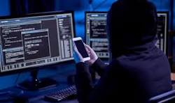
WHO ARE THE END USERS?
The end users of keyloggers are typically cybercriminals or entities engaging in corporate espionage. The potential victims can be anyone using a computer, but particularly those handling sensitive information, such as employees in a corporate setting, individuals conducting financial transactions online, or users entering personal information on the web.

Slide 7

SECURITY IMPLICATIONS
The use of keyloggers can compromise the security of individuals and organizations, leading to data breaches and unauthorized access to sensitive information. It is essential to understand the potential implications.

Slide 8
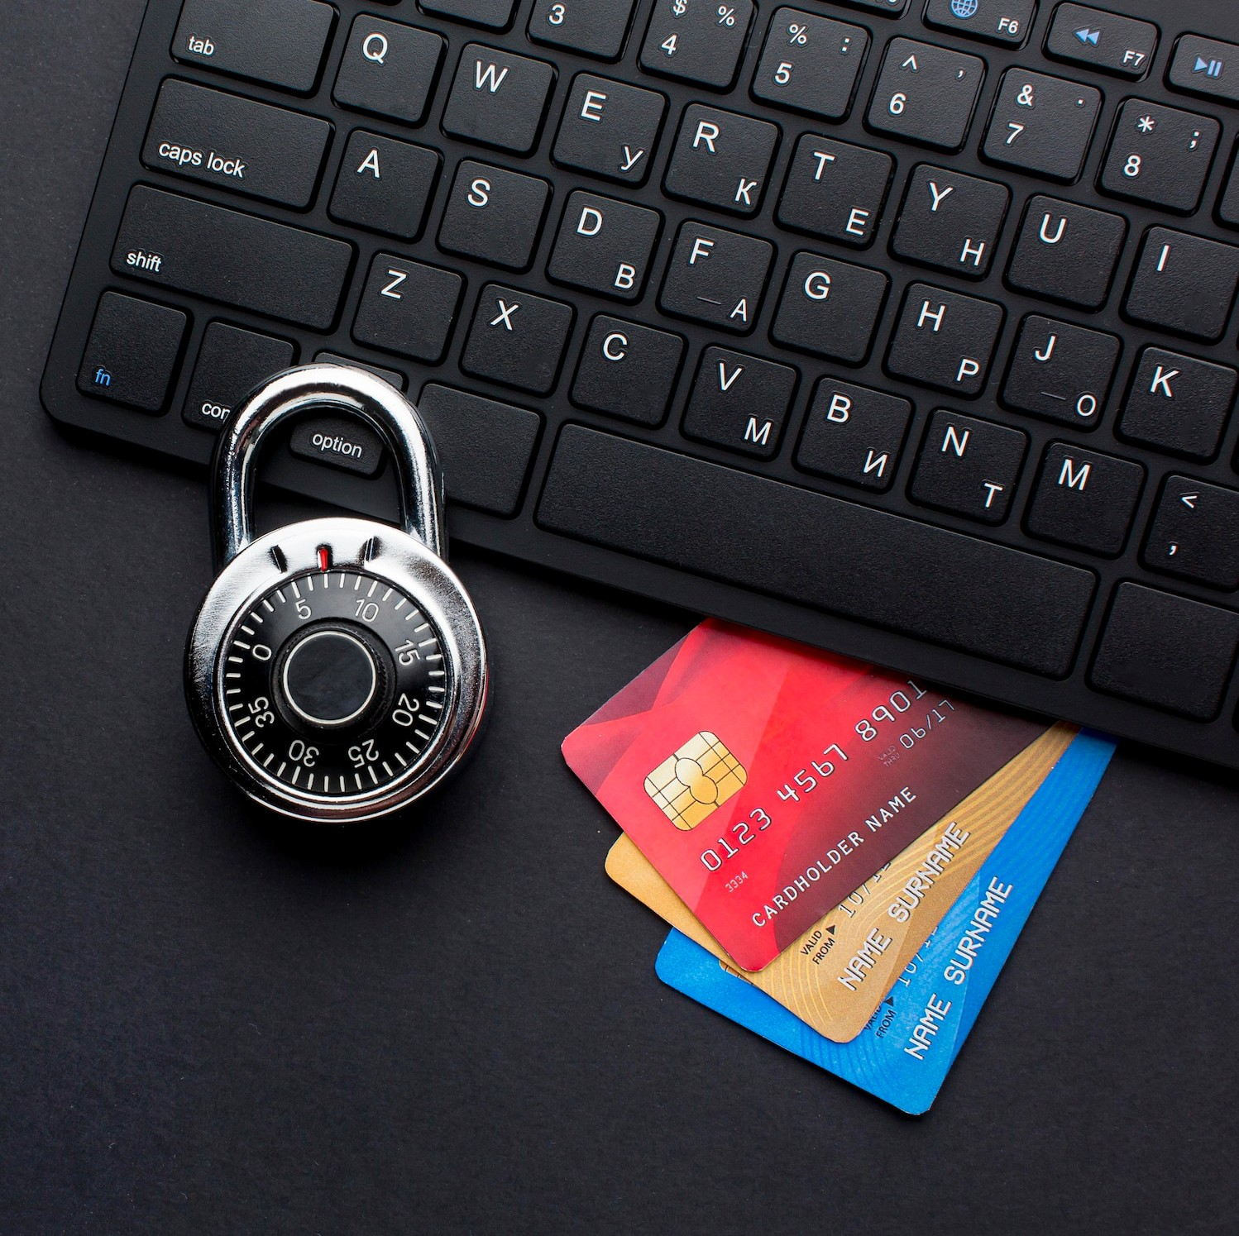
MITIGATING KEYLOGGER THREATS
To mitigate keylogger threats, it is crucial to use antivirus software, regularly update system security patches, and implement encryption for sensitive data. Vigilance is key in preventing keylogger attacks.

Slide 9

BEST PRACTICES FOR PROTECTION
Implementing multi-factor authentication, using virtual keyboards for sensitive input, and conducting regular security audits are best practices to safeguard against keylogger attacks.

Slide 10
RESULTS
Understanding the risks associated with keyloggers is crucial for safeguarding personal and organizational security. By staying informed and implementing preventive measures, individuals and businesses can mitigate the impact of keylogger threats.

